Slide 1
Predicting Airbnb Booking Activity: Chicago
Catherine Yang
6/8/2020

Slide 2
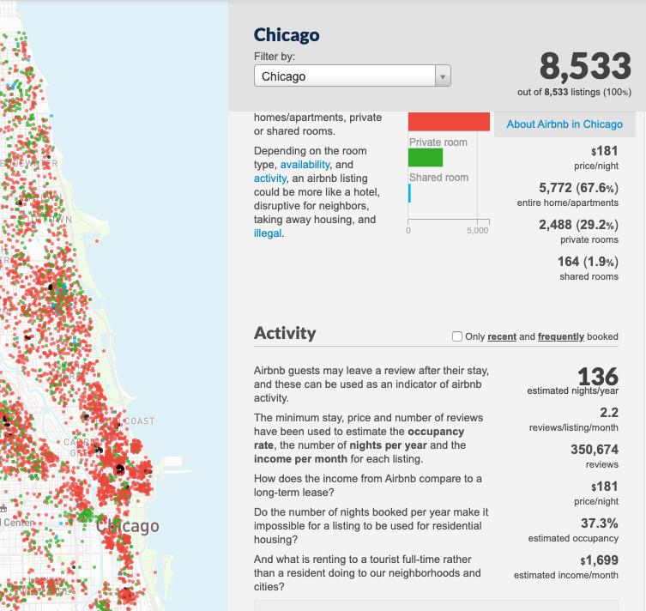
Background
Description:
Predicts the number of reviews per month that an Airbnb listing (or potential listing) in Chicago will receive, based on characteristics pertaining to its host, property, and booking process.
Motivation
To provide hosts with more customized insights into attributes driving listing popularity and increased booking activity.
Existing dashboards only provide aggregated, descriptive statistics without informing how booking activity and user engagement can be improved.
**Number of reviews per month is used as proxy for measuring booking activity but does not explicitly account for listing quality. Through EDA, it is noted that reviews scores are generally high, so it is assumed that listings with higher review count are in general favorable listings, since negative reviews would disincentivize guests from booking those listings.
Source: Inside Airbnb Chicago

Slide 3
Data
Dataset
Chicago Airbnb listings as of 11/21/2019
Source: Inside Airbnb
Features
Host: number of years as host, response time, superhost status, number of listings, etc.
Property: property type, room type, number of bedrooms / beds / bathrooms / guests accommodated, price, etc.
Booking: max / min nights, instantly bookable, cancellation policy, etc.
Performed feature engineering (e.g., binning, categorization) to arrive at appropriate features for modeling
Target Variable
Number of reviews per month
Notes:
Could use more recent listings data, but holiday months could skew availability, and more recent months could have been skewed by COVID-19

Slide 4
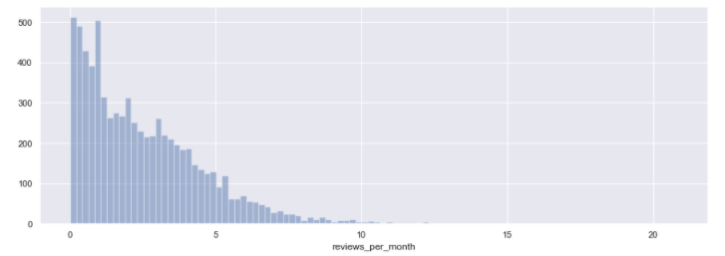
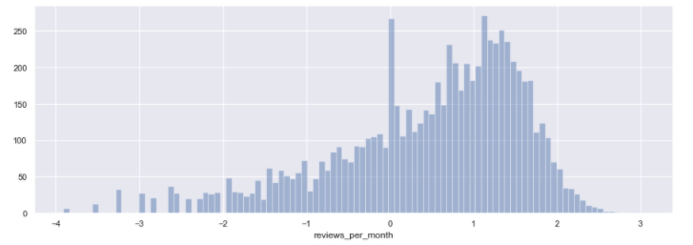
Model & Success Metric
Model
Log-transformed target variable
One-hot encoded categorical features
Standardized numeric predictors
Ensembled a Random Forest Regressor, Gradient Boosted Tree Regressor, and XGBoost Regressor with specific set of weights
Success Metric
Desired RMSE: < 0.5
Measure on average, how far the predicted number of reviews per month is from the actual
Achieved: 0.767
There is margin for improvement!
R2 metric was used for hyperparameter tuning
Histogram of target variable
Histogram of log-transformed target variable
Notes:
Could use more recent listings data, but holiday months could skew availability, and more recent months could have been skewed by COVID-19

Slide 5
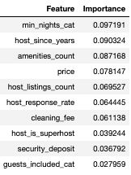
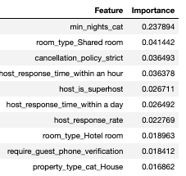
Insights
Random Forest
Model Observations
Surprisingly, XGBoost utilized categorical variables as splitting criteria more than Random Forest or GBM.
Minimum nights required was the most important feature for all models – an obvious result, since shorter stays allow more bookings per month, and thus, greater reviews per month.
Overall Conclusions
Neighborhood location of listing didn’t seem to be a top factor in the number of reviews, indicating that booking activity is generally commensurate with the number listings in an area.
While number of reviews per month is correlated with obvious factors, e.g., host experience, there are a few important features that are more actionable in helping to improve booking activity and user engagement.
XGBoost

Slide 6
Thank You!
Contact Info:
Catherine Yang
catherineyang@u.northwestern.edu
Class of 2016
Consultant, 2016-2019
MS in Analytics

